Slide 1
GNN Based Optimal Path Route For Real Time Accident Detection using Deep Learning Algorithms
Presented By- AYUSH KUMAR SINGH – 21BAI1916
NIKHIL LANGADE-21BEE1196
SANCHIT DAS-21BEC1233 Guide- Dr. Gayathri R

Slide 2
Introduction
Emergency response time is a critical factor in saving lives after an accident.
Traffic congestion and lack of timely alerts cause delays for emergency services.
Our project aims to optimize emergency response routing using deep learning models to detect accidents and notify authorities through Real Time Video Analysis.
We compare MobileNetV2 and YOLOv8 to determine the best model for real-time accident detection.
Real-time traffic patterns and OpenStreetMap data power a GATv2 model for forecasting congestion and optimizing emergency routes.
Heatmaps and congestion maps visualize accident zones and traffic density, enhancing situational awareness and traffic management.

Slide 3
Problem Statement
Delays in emergency response due to late accident detection.
Lack of a system that informs authorities and emergency services in real-time.
No proper mechanism to alert vehicles in the path of an emergency vehicle.
Need for a highly accurate and fast accident detection model.
Limited tools exist to analyze and visualize high-risk zones, hindering proactive traffic safety measures and urban planning.

Slide 4
Research Objective
The goal of this research is to optimize emergency response by detecting accidents in real-time and notifying authorities with accurate location details. The key objectives include:
Accident Detection using Deep Learning:
Implement and compare MobileNetV2 and YOLOv8 for real-time accident detection from CCTV footage.
Analyze their accuracy, response time, and efficiency to determine the better model.
Accident Location Extraction:
Extract the accident location using Geocoder .
Generate a Google Maps link for easy navigation.
Real-Time Notifications using Twilio API:
Instantly notify emergency services (ambulance, police, fire department).
Include accident coordinates and a Google Maps link in the alert message.

Slide 5
Optimized Emergency Routing:
Use Google Maps API to find the fastest route for emergency vehicles.
Factor in real-time traffic conditions to reduce response time.
Alert System for Vehicles in the Emergency Path:
Identify vehicles on the emergency route.
Send automated alert messages requesting them to clear the way.
Comparison of MobileNetV2 and YOLOv8:
Evaluate both models based on accuracy, response time, and resource usage.
Identify the best-performing model for real-world deployment
Design a predictive traffic congestion model using GNN-GATv2
Leverage graph neural networks and OpenStreetMap data to forecast congestion and optimize emergency vehicle routing dynamically.
To visualize accident hotspots and traffic density patterns
Build interactive, data-driven maps highlighting high-risk zones and congestion levels to enhance urban traffic management and safety planning.

Slide 6
Proposed System
Deep learning-based accident detection using CCTV footage.
Twilio API for real-time notification to emergency teams.
Google Maps API for accident location sharing and route optimization.
Message alerts to nearby vehicles for clearing the emergency route.
Comparison of MobileNetV2 and YOLOv8 for accuracy and response time.
Graph-Based Traffic Congestion Prediction System to form a dynamic traffic graph.
Urban Safety Visualization Dashboard to map historical accident zones and current congestion levels

Slide 7
Proposed System Introduction
MobileNetV2 and YOLOv8 models process CCTV footage to detect accidents.
The system extracts accident location and sends real-time alerts via Twilio API.
Google Maps API provides optimized routes for emergency response teams.
Nearby vehicles receive messages to clear the route, reducing response time.
GNN creates models of city roads using OSMnx with real-time data to form a dynamic traffic graph.

Slide 8
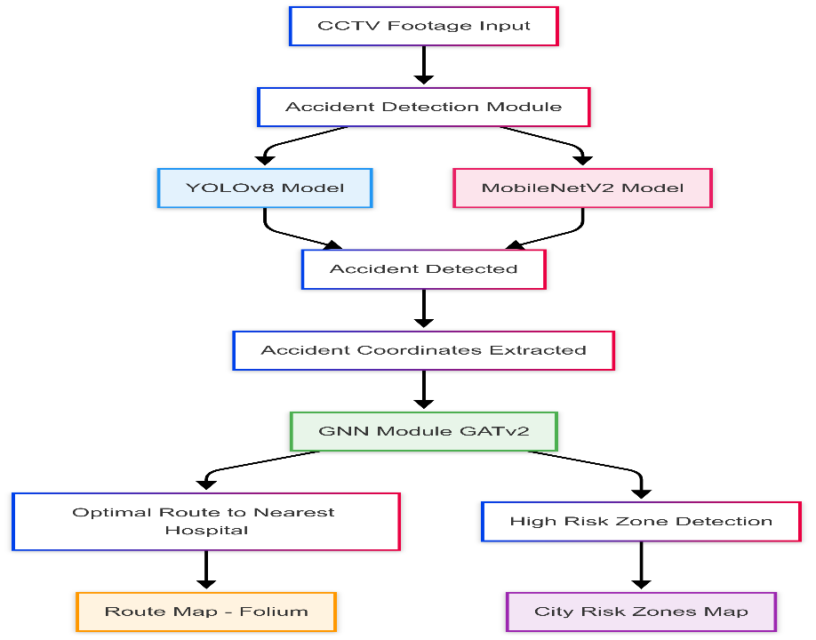
Proposed System Diagram

Slide 9
List of Modules
Accident Detection Module (Deep learning model for accident classification)
Accident Location Extraction Module (Extracts coordinates from CCTV using Geocoder)
Notification Module (Uses Twilio API to alert authorities)
Route Optimization Module (Google Maps API for best emergency route)
Alert System for Vehicles (Sends messages to vehicles in the emergency path)
Traffic Prediction & Routing Module (Converts road networks into graphs and Predicts real-time congestion levels)
Visualization & Urban Analytics Module (Highlights high-risk zones based on historical and real-time data)

Slide 10
Explanation of All Modules
1. Accident Detection Module
Algorithm Used:
MobileNetV2 – Lightweight CNN for fast image classification.
YOLOv8 – Object detection model for real-time processing.
Process:
Extract frames from CCTV footage using OpenCV.
Preprocess frames (resizing, normalization, augmentation).
Feed frames into MobileNetV2/YOLOv8 for classification.
If an accident is detected, trigger further processes.

Slide 11
2. Accident Location Extraction Module
Algorithm Used:
Geospatial mapping techniques using OpenCV & GPS metadata.
Process:
Extract GPS metadata from CCTV feeds.
If metadata is unavailable, map accident coordinates manually.
Generate Google Maps link for the accident location.
3. Notification Module
Algorithm Used:
Twilio API for real-time messaging.
Process:
Retrieve accident location (latitude & longitude).
Send SMS to authorities and emergency services with:
Accident coordinates
Google Maps link
Short alert message

Slide 12
4. Route Optimization Module
Algorithm Used:
Google Maps API (Dijkstra’s Algorithm / A Algorithm for shortest path).*
Process:
Use Google Maps API to calculate the fastest route.
Factor in real-time traffic conditions.
Display optimized route to emergency responders.
5. Alert System for Vehicles
Algorithm Used:
Twilio API for SMS broadcasting.
Process:
Identify vehicles on the emergency route.
Send alert message:
"Emergency vehicle approaching. Please clear the way."
Improve compliance to reduce response time.

Slide 13
6. Traffic Prediction & Routing Module
OSMnx – Extracts and visualizes real-world road networks from OpenStreetMap.
Graph Construction – Converts road networks into graphs (nodes and edges) with lane- level detail.
GNN-GATv2 Model – Predicts real-time congestion levels using graph attention networks.
Dynamic Route Optimization – Suggests the fastest path for emergency responders.
7. Visualization & Urban Analytics Module
Accident Heatmap Generator – Highlights high-risk zones based on historical and real-time data.
Traffic Congestion Maps – Color-coded maps to indicate varying traffic densities across city routes.
Dashboard UI – Centralized interface to monitor alerts, accident zones, and traffic status.

Slide 14
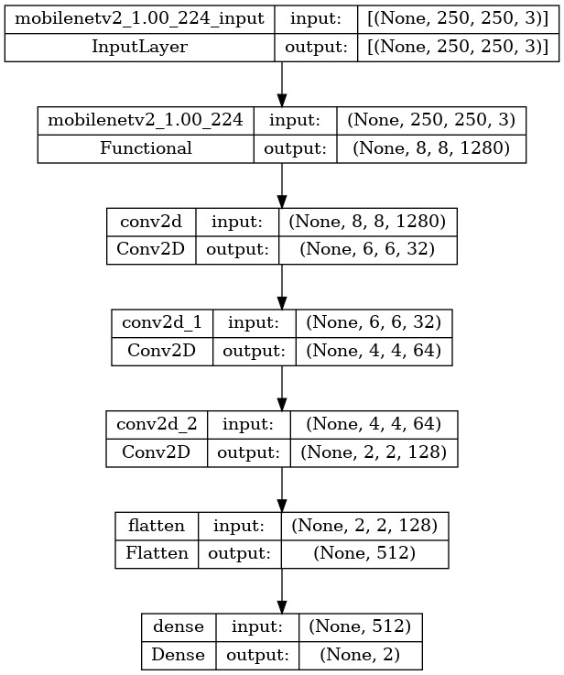
Architecture of MobileNetV2 :-
1. Model Architecture
The image illustrates the structure of a MobileNetV2-based model designed for accident detection.
The model begins with an input layer that accepts images of size 250x250x3 (height, width, channels).
It then employs a MobileNetV2 architecture to extract features from the input images.
2. Feature Extraction and Processing
The extracted features are further processed through a series of convolutional layers (Conv2D) and a flatten layer.
These layers progressively reduce the dimensionality of the feature maps while capturing relevant information for accident detection.
3. Classification
Finally, a dense layer (fully connected layer) is used to classify the processed features into two categories: accident or non-accident.
The output of this dense layer is a vector of size 2, with each element representing the probability of the input image belonging to one of the two classes.

Slide 15
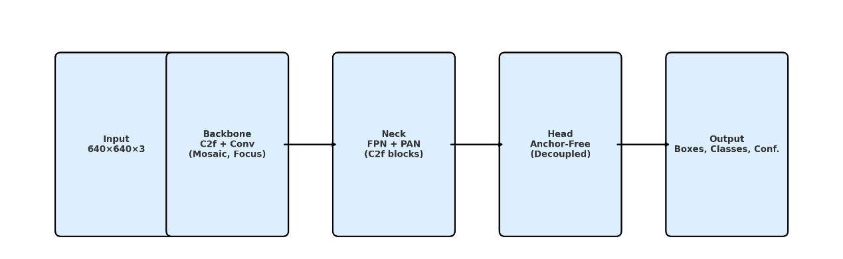
Architecture of YOLOv8 :-
1. Input Layer:
Typical input size: 640×640×3.
Images are resized and normalized.
Supports dynamic input sizes for flexible deployment.
2. Backbone:
C2f Modules: Efficient variant of CSP, reducing computation with preserved accuracy.
Conv Blocks: Standard convolution + BatchNorm + SiLU activation.
Focus Layer: Enhances feature richness (in some versions).
3. Neck:
FPN + PAN: Multi-scale feature fusion for better object detection across sizes.
C2f Blocks: Used here for efficiency.
4. Head (Anchor-Free & Decoupled):
Anchor-Free: Predicts object centers and sizes directly, reducing hyperparameters.
Decoupled Head: Separate branches for classification and regression to improve accuracy and training speed.
5. Output:
Outputs include bounding boxes, class labels, and confidence scores in a single pass.

Slide 16
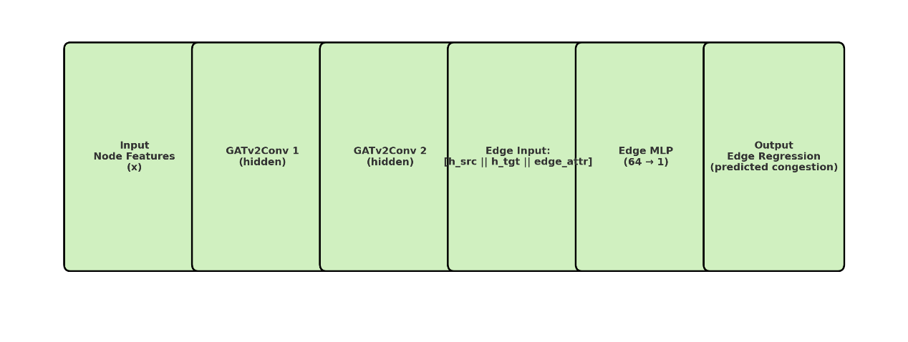
Architecture of GNN :-
1. Input – Node Features (x): Input matrix : 𝑥∈𝑅𝑛×𝑓 where n is the number of nodes and f is features per node (e.g., lane count, traffic signals).
2. GATv2Conv Layer 1: Applies 2-head multi-head self-attention to capture relationships between nodes. Outputs hidden features by aggregating neighbor info.
g
3. GATv2Conv Layer 2: Uses a single-head attention mechanism to refine embeddings. Final node embeddings (h_src, h_tgt) are activated using ELU.
4. Edge Input Construction: Concatenates h_src, h_tgt, and edge attributes to form edge-level features that reflect both node and edge context.
5 Edge-Level MLP: A feedforward network with an input size of 2×hidden_channels+edge_dim, one hidden layer (64 units, ReLU), and one output neuron.
6. Output – Edge Regression: Outputs a scalar per edge (0–1), representing predicted congestion, aiding real-time traffic-aware routing.

Slide 17
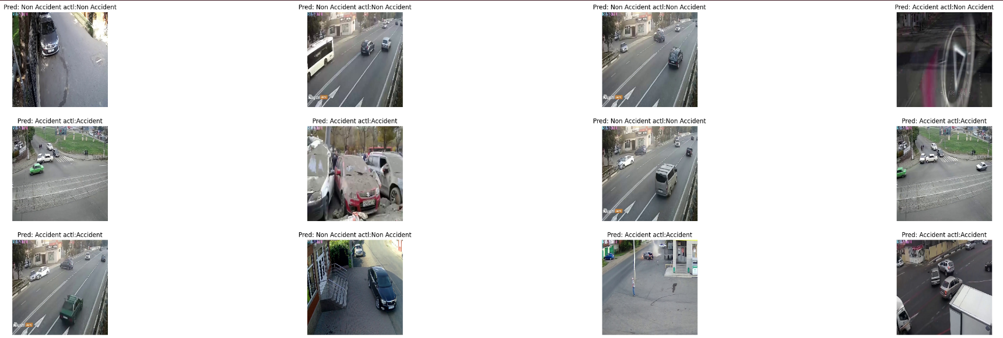
Prediction vs Actual for Mobilenetv2

Slide 18
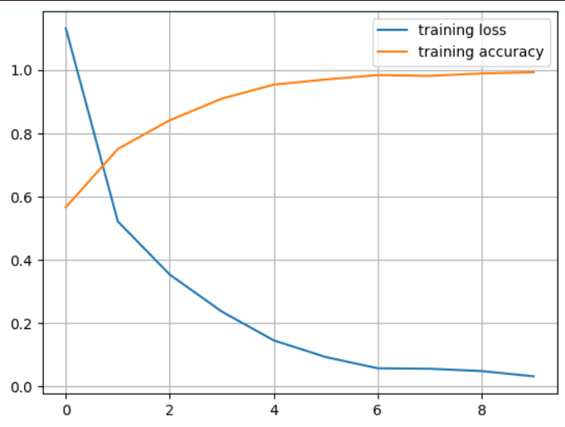
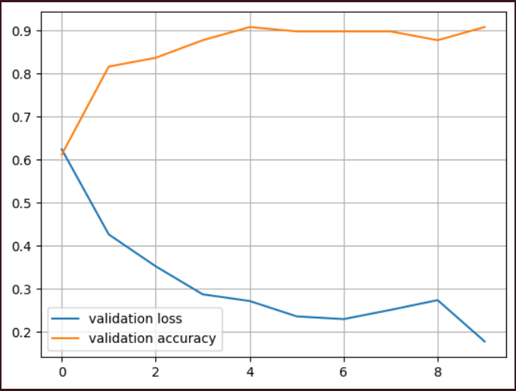
TRAINING LOSS V/S ACCURACY
VALIDATION
LOSS V/S ACCURACY

Slide 19
Results
Metric | YOLOv8 | MobileNetV2
Accuracy | 92.5% | 91.0%
Precision | 86% | 90.5%
Recall | 93.0% | 91.2%
Processing Speed | 45ms per frame | 50ms per frame
Model Size | 244 MB | 14 MB
Hardware Requirements | High (GPU recommended) | Low (Can run on CPU)

Slide 20
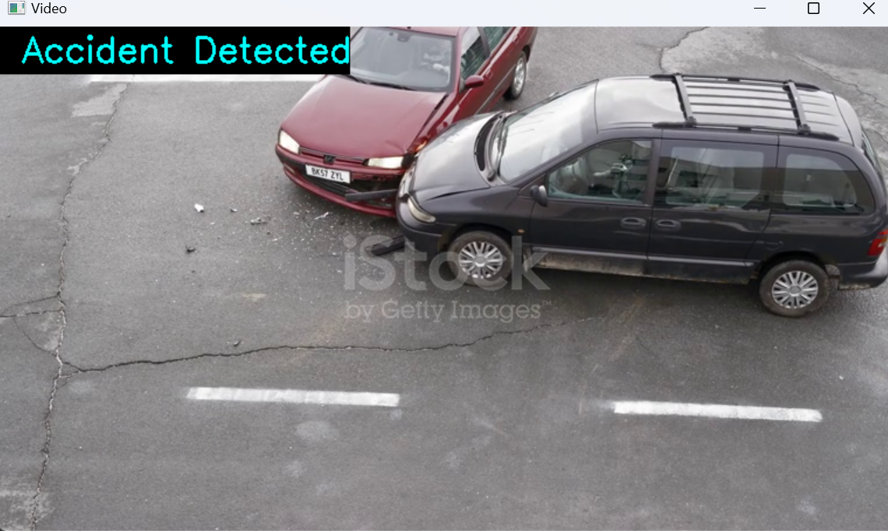
Output of MobileNetV2

Slide 21
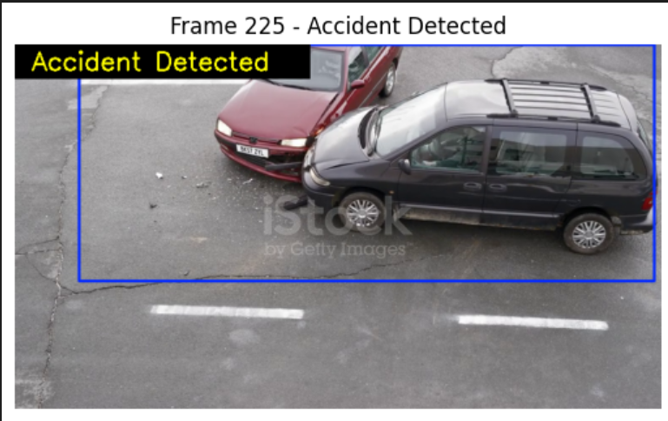
Output of YOLOv8

Slide 22
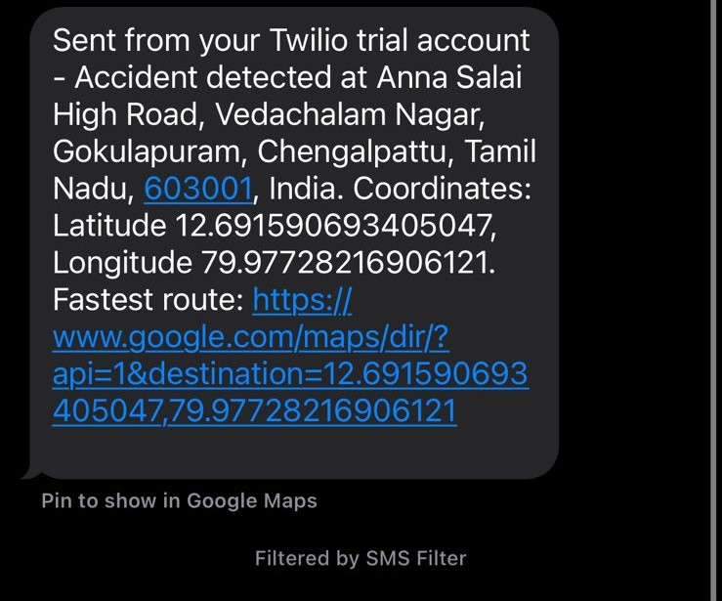
Message Received by Authorities

Slide 23
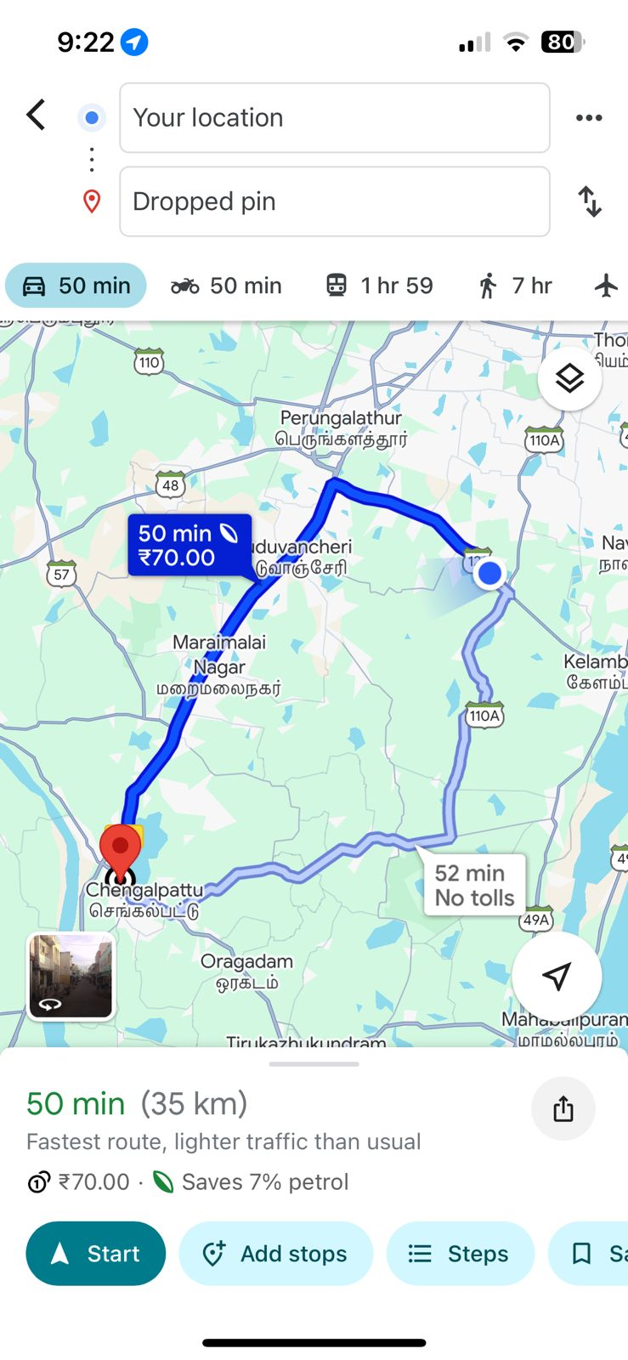

Slide 24

Message received to Vehicles on the way of Emergency response vehicle

Slide 25
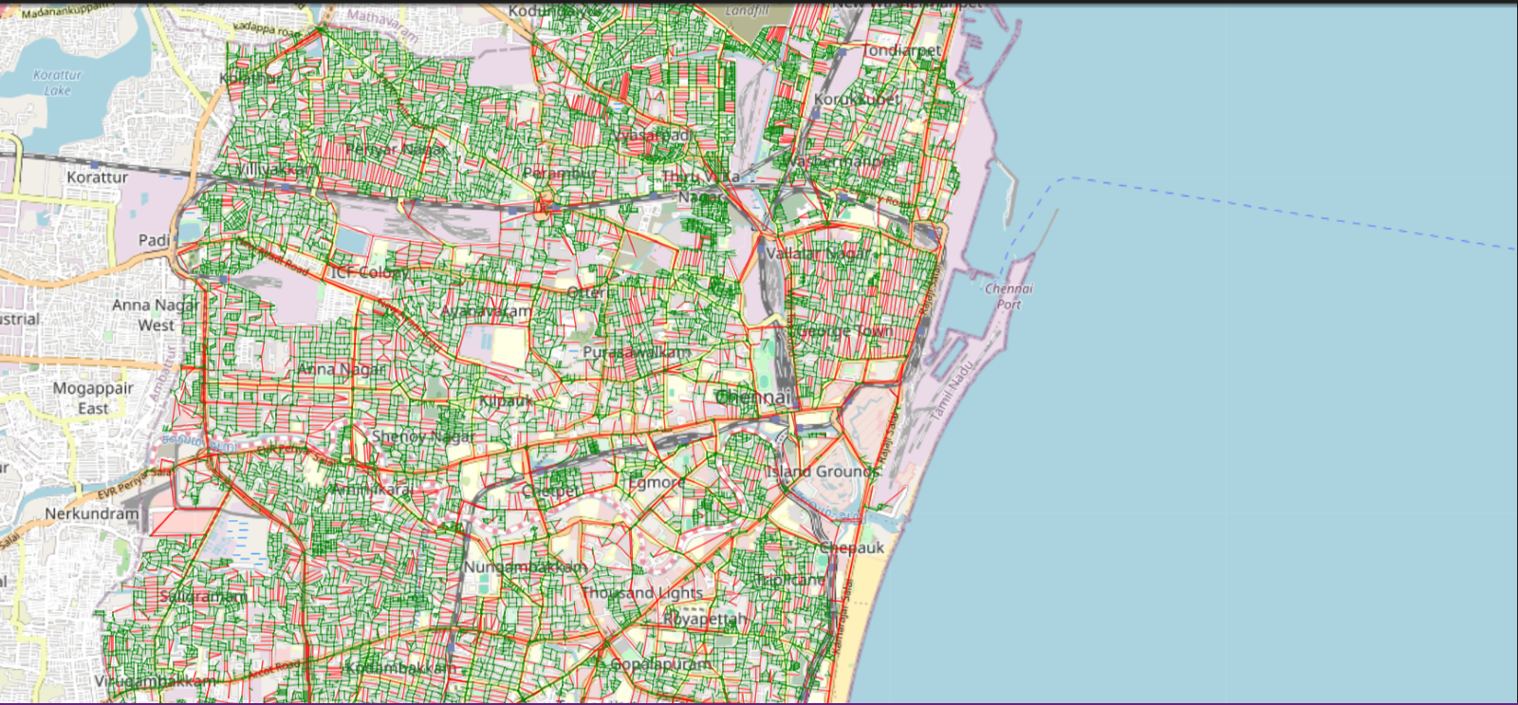
CONGESTION MAP OF CHENNAI

Slide 26
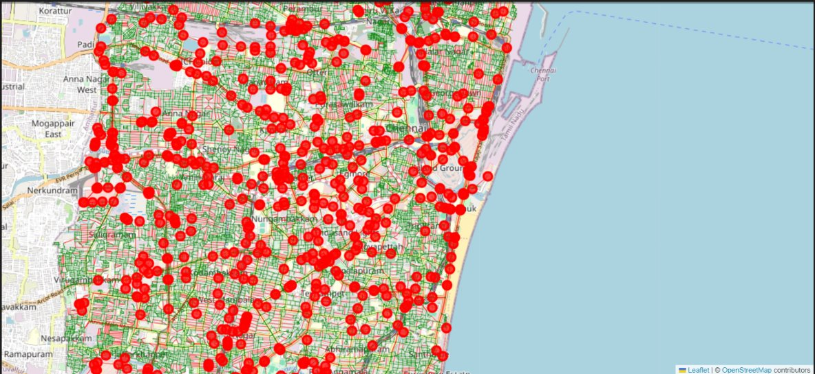
GNN based high risk zones in Chennai

Slide 27
Table: Comparative Evaluation of Routes from Position 1 to Position 2
Scenario | Start Location | Destination (Hospital) | Distance (km) | Time (min) | Risk Zones Passed | High-Risk Zones Avoided (%)
1. | T. Nagar (Busy Intersection) | Bharathirajaa Hospital & Research Centre | 1.9 | 4 | 0 | 90%
2. | Velachery (Residential) | Fortis Malar Hospital, Adyar | 9.8 | 22 | 12 | 81%
3. | Chennai Central | Chennai Airport | 18.2 | 39 | 11 | 84%

Slide 28
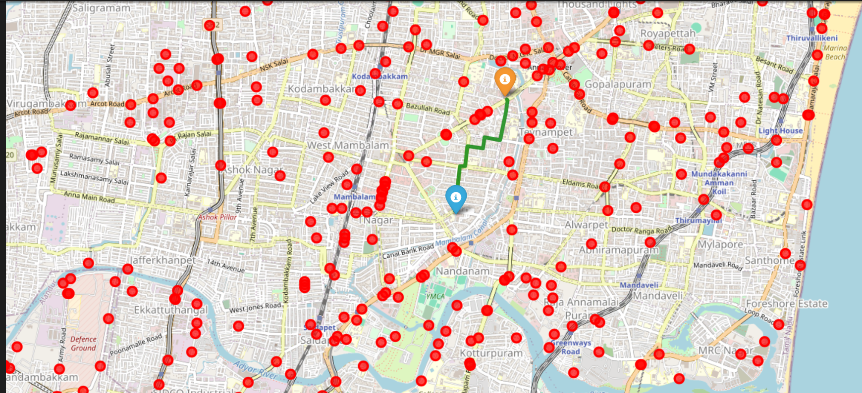
Route for Scenario 1
Fig: Scenario 3

Slide 29
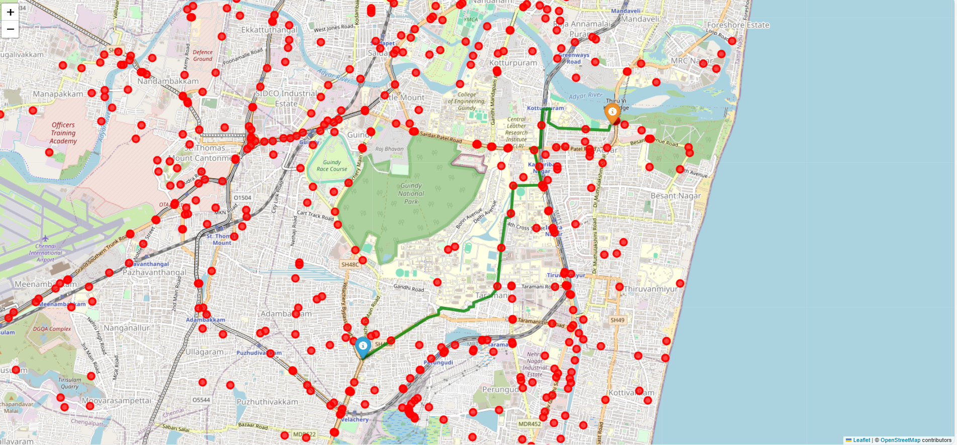
Route for Scenario 2

Slide 30
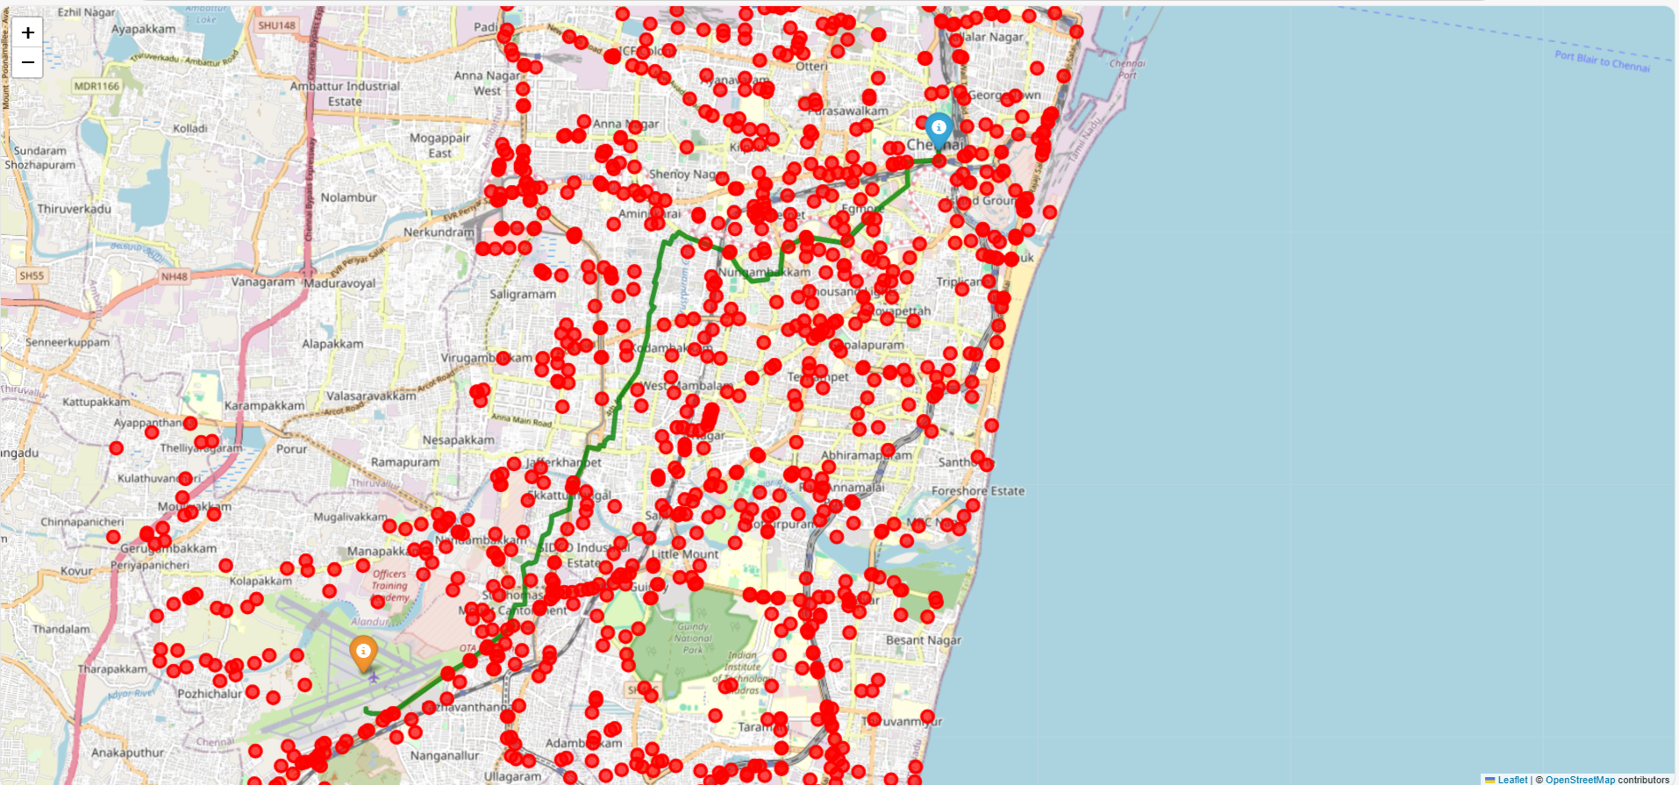
Route for Scenario 3

Slide 31
Standards Used
IEEE 802.11 / 802.15 (Wi-Fi / IoT Communication Standards) Used for reliable wireless communication between IoT devices, sensors, and edge computing units in smart traffic environments.
NMEA 0183 (GPS Data Standard) Standard protocol for GPS modules to transmit geolocation data (latitude, longitude, time) to the emergency alert system.
RESTful API Standards Twilio and mapping services use REST APIs for consistent, scalable, and standardized communication in sending SMS alerts and location sharing.
OpenStreetMap (OSM) Data Standard Adheres to open geospatial data standards, ensuring accurate and structured road network information for GNN-based traffic modeling.
Machine Learning Model Evaluation Metrics (ISO/IEC 20546:2019 Guidelines) Standardized metrics like accuracy, precision, recall, and F1-score are used for model validation and benchmarking.
Data Privacy and Security Standards (GDPR-like Guidelines for Location Sharing) Follows ethical standards in handling user geolocation and personal data during emergency alert transmissions.

Slide 32
Conclusion and Future Work
.
The implementation of transfer learning through MobileNetV2 proved instrumental in achieving high accuracy while maintaining computational efficiency. The model's successful conversion to TensorFlow Lite format demonstrates its viability for deployment on edge devices, making it particularly suitable for existing CCTV infrastructure.This integration of computer vision and automated communication channels represents a significant step forward in intelligent transportation systems and emergency response mechanisms
For future work a generated traffic congestion map from the GNN will effectively visualize congestion levels across the urban road network, which can be directly utilized with Dijkstra’s algorithm to compute optimal paths.
Advanced GNNs & Adaptive Rerouting, the use of more sophisticated Graph Neural Network models, including enhanced GATv2 and Graph Transformers, will allow for more accurate traffic congestion prediction. Combined with adaptive rerouting, emergency vehicle paths can be recalculated in real-time as traffic conditions change, ensuring optimal routing throughout their journey.
Scalability, Policy Integration & Continuous Feedback, scaling the system to diverse urban settings and integrating it into public emergency frameworks will ensure broader real-world applicability. Additionally, implementing continuous feedback loops based on user experience and system performance will drive iterative improvements in both detection accuracy and traffic prediction efficiency.

Slide 33
Research Paper Status
Paper Status : Draft ready
Target Journals:
IEEE Access
Springer
Elsevier

Slide 34
References
M. M. Kaushik, M. Kakkar, M. Yadav, P. Kaushik, S. Jha, and V. Jaitwal, "Smart Road Segmentation from Aerial Images," 2023 International Conference on Smart Devices (ICSD), Dehradun, India, 2024, pp. 1-6, doi: 10.1109/ICSD60021.2024.10751072.
C. Sharma, L. Tomar, and A. Jain, "Augmented Reality for Emergency Responders: A Bibliometric Review and Future Directions," 2024 IEEE International Symposium on AR and AI, 2024, pp. 145-152, doi: 10.1109/ISARAI.2024.10625425.
R. Ratheesh, S. SR, and S. Dhanusha, "AI-Based Smart Visual Assistance System for Navigation, Guidance, and Monitoring of Visually Impaired People," 2024 IEEE Smart Cities Conference (ISC2), 2024, pp. 101-108, doi: 10.1109/ISC2405687.2024.10568710.
E. Maimaitijiang, T. Wali, A. Bolatbekov, and D. Salman, "A Novel Recommender Framework with Chatbot to Stratify Heart Attack Risk," Discover AI, vol. 5, no. 2, 2024, doi: 10.1007/s44337-024-00174-9.
B. S. Rajeshwari, Y. Vinay, and T. A. Kumar, "Emergency Response Optimization System with Dynamic Traffic Signal Control: (Life Saver)," 2024 IEEE Intelligent Transportation Systems Conference (ITSC), 2024, pp. 350-357, doi: 10.1109/ITSC.2024.10696762.

Slide 35
S. Luthfiyah, T. Triwiyanto, and M. Ismath, "Traffic Patterns and Emergency Medical Services Prenotification Transport Estimates in Trauma Activations," Open Access Emergency Medicine, vol. 17, 2025, pp. 201-215, doi: 10.2147/OAEM.S502924.
J. Ren and J. Hancock, "Accurate Traffic State Prediction with Deep Learning: Analyzing Statistical Aides for Identifying Anomalous Traffic Trends," 2024 IEEE International Conference on Data Science (ICDS), 2024, pp. 78-85, doi: 10.1109/ICDS.2024.10763550.
M. A. Raza, Y. Z. Alharthi, and G. Abbas, "Visual Detection of Traffic Incident through Automatic Monitoring of Vehicle Activities," World Electric Vehicle Journal, vol. 15, no. 9, 2024, doi: 10.3390/wevj15090382.
P. Singh, A. Bansal, S. Porwal, and M. Malik, "Identification of Collided Vehicles in Indian Traffic Accidents using Hierarchical Deep Learning Framework," Research Square, 2024, doi: 10.21203/rs.3.rs-5664146/v1.
R. Mande, R. Mohammad, and S. S. Potluru, "Road Anomaly Detection Utilizing Swin Transformer and Deep Convolutional Neural Networks with YOLOv8," Lecture Notes in Computer Science, vol. 142, 2024, pp. 210-220, doi: 10.1007/978-981-97-6992-6_28.

Slide 36
N. Hernández-Díaz, Y. C. Peñaloza, and Y. Y. Rios, "A Computer Vision System for Detecting Motorcycle Violations in Pedestrian Zones," Multimedia Tools and Applications, vol. 83, no. 4, 2024, pp. 3021-3038, doi: 10.1007/s11042-024-19356-9.
N. Vijayan, S. Pandey, and R. M. Pramila, "Collision Detection and Prevention for Automobiles Using Machine Learning," 2024 IEEE International Conference on AI and Automotive Safety, 2024, pp. 189-195, doi: 10.1109/AIAUTO.2024.10545080.
A. Inbavalli and T. Jarshini, "Efficient Aggressive Behavior Detection and Alert System Employing Deep Learning Techniques," 2024 IEEE International Conference on Smart Technologies (ICST), 2024, pp. 60-67, doi: 10.1109/ICST.2024.10486157.
S. Rahman, J. H. Rony, J. Uddin, and M. A. Samad, "Real-Time Obstacle Detection with YOLOv8 in a WSN Using UAV Aerial Photography," Journal of Imaging, vol. 9, no. 10, 2023, doi: 10.3390/jimaging9100216.
A. Sugiharto and R. Kusumaningrum, "Automated Detection of Driver and Passenger Without Seat Belt using YOLOv8," Journal of Transportation Safety & Security, vol. 12, no. 4, 2023, pp. 542-555, doi: 10.1080/2158107X.2023.174053688.

Slide 37


GNN BASED OPTIMAL PATH ROUTE FOR REAL TIME ACCIDENT DETECTION USING DEEP LEARNING ALGORITHMS
Ayush Kumar Singh - 21BAI1916
Sanchit Das – 21BEC1233
Nikhil Nilam Langade – 21BEE1196
Dr.Gayathri R
School of Computer Science Engineering
MOTIVATION / INTRODUCTION
Road accidents in urban areas are a growing concern, with emergency response often delayed due to manual detection and navigation limitations.
.
Our project combines deep learning and graph neural networks to detect accidents and guide emergency vehicles optimally using smart path routing.
By leveraging live CCTV feeds and real-time geospatial data, the system ensures faster and safer responses.
OBJECTIVES
To develop a real-time accident detection system using deep learning models.
To build a GNN model (GATv2) that generates optimal emergency routes by avoiding accident-prone areas.
To integrate geospatial data from OpenStreetMap and visualize accident hotspots and safe paths on interactive maps using Folium.
.
SCOPE OF THE PROJECT
This system aims to enhance emergency response in urban areas by detecting road accidents in real time and guiding responders through safe, optimized routes.
.
Accident detection for YOLOV8
METHODOLOGY
Live CCTV footage is analyzed using YOLOv8 and MobileNetV2.
GPS coordinates are passed to a GATv2 model, which computes the safest route to the nearest hospital using OSMnx road networks.
Folium maps visualize both accident hotspots and optimal emergency paths, while alerts are sent via Twilio with live location links.
ARCHITECTURE
RESULTS
Optimal path provided by GNN
CONCLUSION
The system efficiently detects accidents using deep learning and optimizes emergency routing with GNNs.
With real-time alerts, interactive maps, and 93% detection accuracy, it improves urban emergency response and safety.
CONTACT DETAILS
NAME MAIL ID MOBILE NO
Ayush Kumar Singh ayushkumar.singh2021@vitstudent.ac.in 9060100628
Sanchit Das Sanchit.das2021@vitstudent.ac.in 9205523904
Nikhil Langade nikhilnilam.langade2021@vitstudent.ac.in 8080841173
REFERENCES
H. Sherif, M. A. Shedid, and S. A. Senbel, “Real-time traffic accident detection for intelligent transportation systems,” International Journal of Computing, vol. 23, no. 3, pp. 440–449, 2024.
N. Makarov, S. Narayanan, and C. Antoniou, “Graph neural network surrogate for strategic transport planning,” IET Intell. Transp. Syst., 2024 (in press).
Metric | YOLOv8 | MobileNetV2
Accuracy | 92.5% | 91.0%
Precision | 86% | 90.5%
Recall | 93.0% | 91.2%
F1 Score | 92.4% | 90.8%

Slide 38
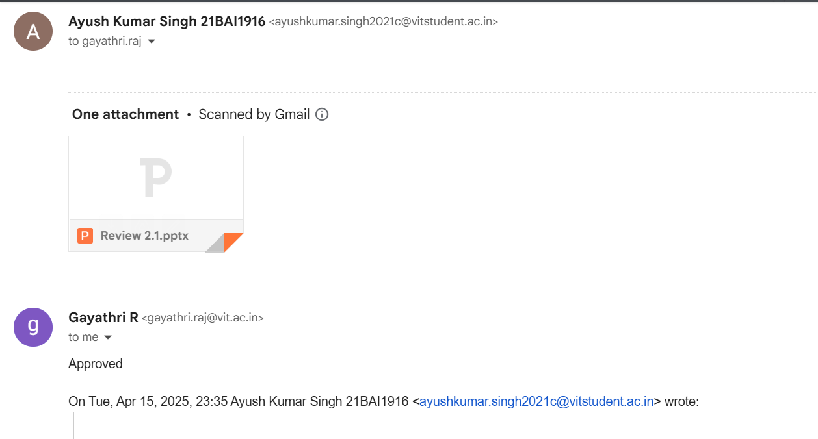
Guide Approval

